Slide 1

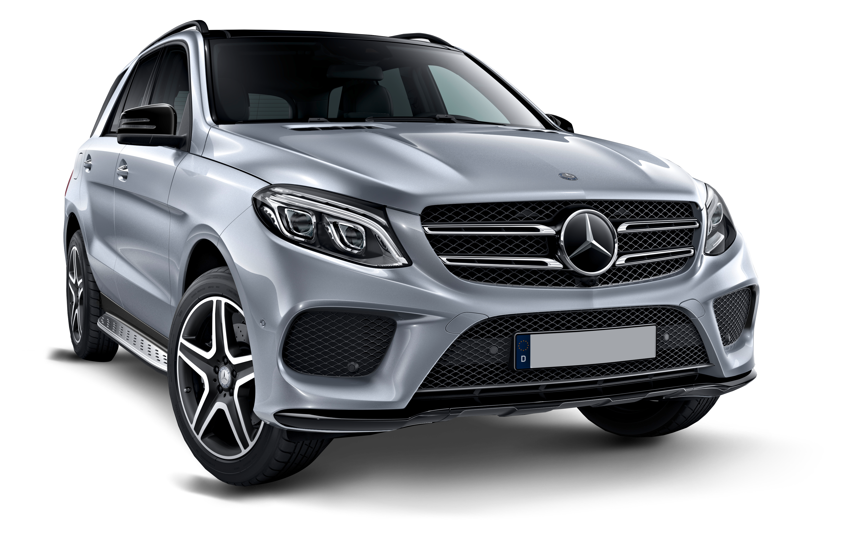
Car Price Prediction
Arpita Rai
Int_33
This Photo by Unknown Author is licensed under CC BY-NC

Slide 2
Abstract
Car price prediction has picked researchers' interest since it takes a significant amount of work and expertise on the part of the field expert. For a dependable and accurate forecast, a large number of unique attributes are analyzed. We employed 5 different machine learning approaches to develop a model for forecasting the price of used automobiles. The respective performances of different algorithms were then compared to discover the one that best suited the existing data set. The final prediction model was implemented in a python programs. Furthermore, the model was tested with test data, yielding an accuracy of 87.76 percent.

Slide 3
Problem statement
With the Coronavirus sway on the lookout, we have seen lot of changes in the vehicle market. Presently some vehicles are sought after subsequently making them exorbitant and some are not popular consequently less expensive. With the adjustment of market due to Coronavirus 19 effect, people/sellers are facing issues with their past Car Price valuation AI/Machine Learning models. Along these lines, they are searching for new AI models from new information. Here we are building the new car price valuation model.
The primary point of this venture is to create a dataset with the help of web scraping and anticipate the cost of trade-in vehicle in view of different elements.

Slide 4
Collecting the data
We have scraped the data for over 4340 cars using Selenium script from 3 different websites from different locations around the country. The websites are as followed:
1. OLX
2. Cars24
3. CarDekho

Slide 5
There are columns:
Name' : It gives us the brand of the car along with its model.
‘Year' : It gives us the year of manufacturing of the car model
'Fuel Type' : It gives us the type of fuel used by the car
'Driven Kilometers' : It gives us the total distance in kms covered by car
'Transmission' : It tells us whether the gear transmission is Manual or Automatic
'Owner' : It tells us the total numbers of owners car had previously
‘Seller Type' : It gives us the idea that the car belongs to individual or dealer
8. 'Price (in ₹)' : It gives us the price of the car.
Here 'Price (in ₹)' is our target variable.

Slide 6
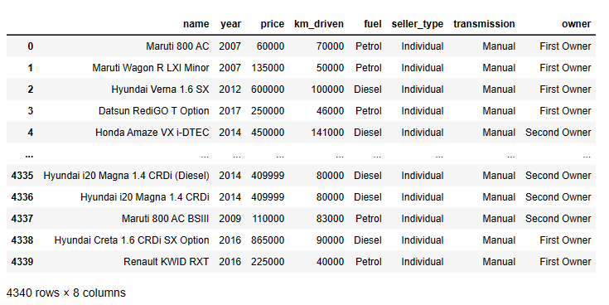
Reading the dataset
Now we read the dataset into Pandas and since the target column ‘Price’ is of integer datatype, we will apply regression algorithms on it.

Slide 7
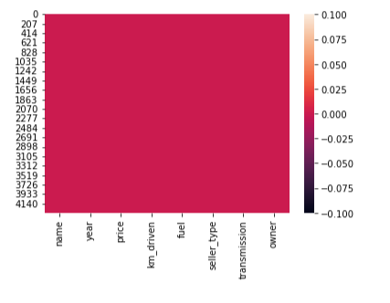
Data Cleaning
We check for null values and find that there are no null values in the dataset.
Since all the features are categorical hence we need not check for outliers and skewness.

Slide 8
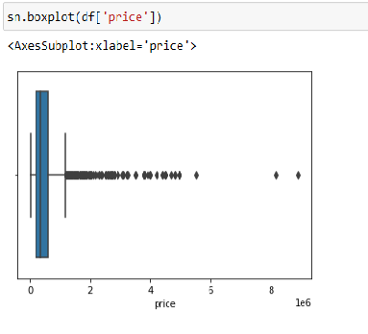
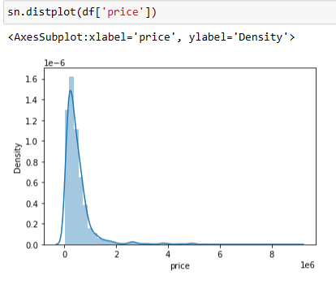
Exploratory data analysis
Firstly, we will plot boxplot and distribution plot for target variable. And find that there are few outliers which need not be treated and the data is tightly distributed with almost normalized distribution.

Slide 9
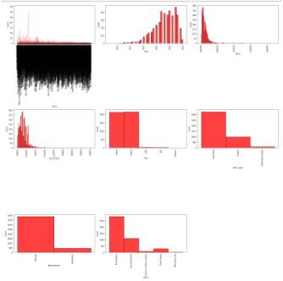
Histogram
~ Brands, Driven Kilometers & Year have a wide range of values in them.
~ Maximum Cars run on either Petrol or diesel. Only few goes for CNG and other fuels.
~ Maximum Cars have Manual transmission.
~ Maximum cars are being sold by their very 1st Owner.
~ Almost all the cars have a price ranging in between 600000to 135000.

Slide 10
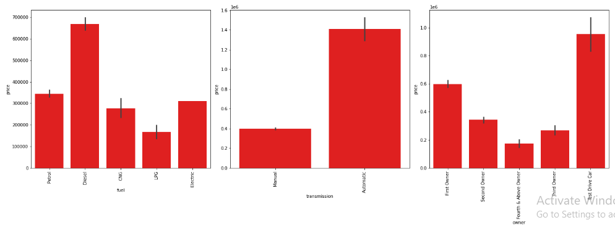
Bar graph
Since Brands, Driven Kilometers & Yearhave a wide range of values in them, we will not perform bivariate analysis for them as they will not give us any specific details. Now by plotting graph of Fuel type, Transmission and Owner against Price, we conclude that Car that uses Diesel, have automatic Transmission and Has only 1 owner is more likely to have a high price.

Slide 11
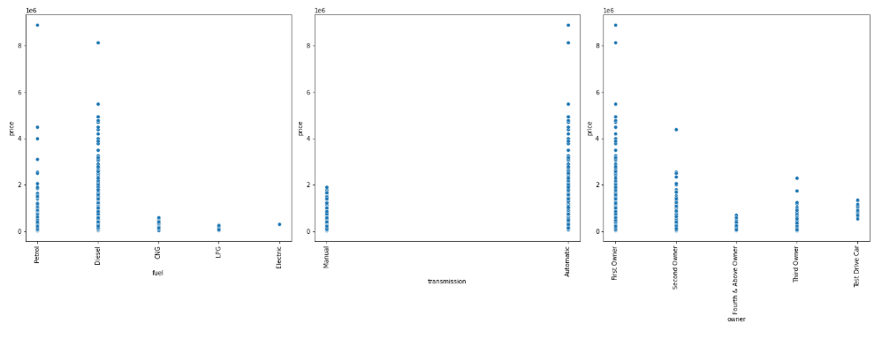
Scatter plot
Just like bar graph, we can see that Price range is likely to be high for cars using Diesel as fuel, or having Automatic Transmission or is owned by only 1 Owner.

Slide 12
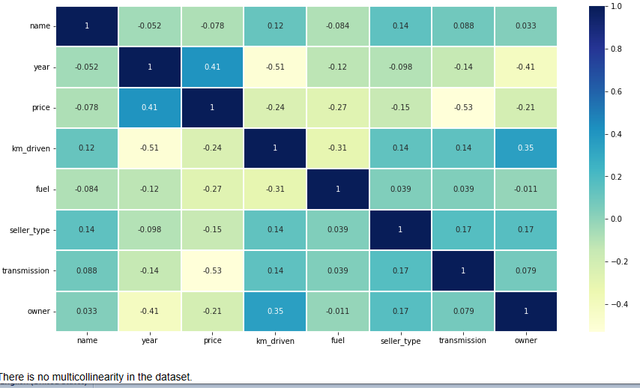
Heatmap
Heatmap suggests that there is no multi-collinearity in the dataset.

Slide 13
Model building
The models used training and testing datasets are as followed:
Linear Regression
SGD Regressor
KNeighbors Regressor
Decision Tree Regressor
Random Forest Regressor
Only Decision Tree Regressor and Random Forest Regressor are performing well and giving accuracy of 67.8 % and 78.8% , respectively.

Slide 14
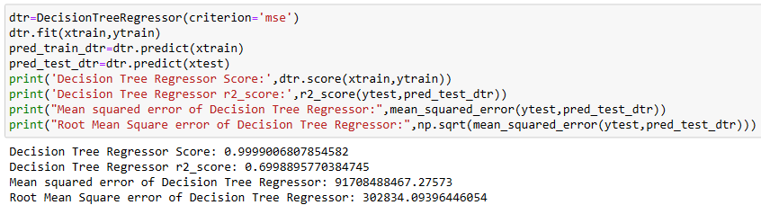
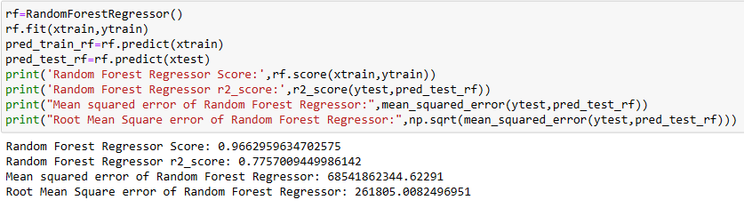

Slide 15
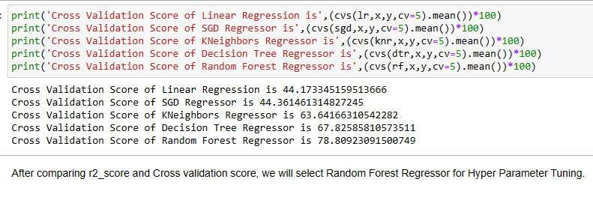
Cross validation score
After comparing r2_score and Cross validation score, we will select Random Forest Regressor for Hyper Parameter Tuning.

Slide 16
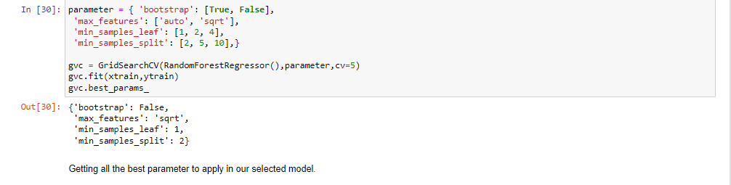
Hyper parameter tuning

Slide 17
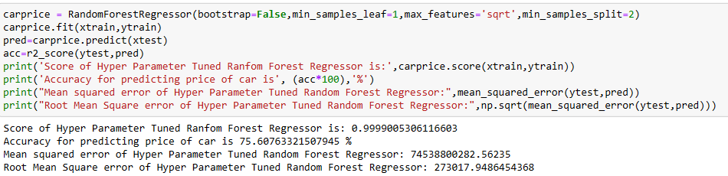
Final model
The accuracy of Model ‘CarPrice' (Random Forest Regressor) after applying Hyper Tuned Parameters is found to be 75.61% and the score is 0.99 which is quite good.

Slide 18
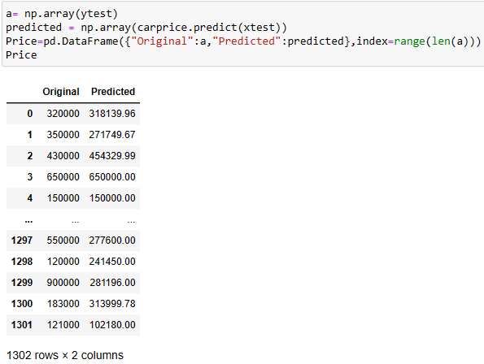
Conclusion
Here, we can see that all the predicted prices are either nearly equal or very close to the original prices of the car. Hence we conclude that our model ‘carprice' is working very well. And we shall save it for further use.

Slide 19
Limitations of this work and Scope for Future Work
As a part of future work, we aim at the variable choices over the algorithms that were used in the project. We could only explore two algorithms whereas many other algorithms which exist and might be more accurate. More specifications will be added in a system or providing more accuracy in terms of price in the system i.e.
1) Horsepower
2) Battery power
3) Suspension
4) Cylinder
5) Torque

Slide 20
Thank you

